Slide 1

An Automated Annotation System for Document Text Images
GOKARAJU RANGARAJU INSTITUTE OF ENGINEERING AND TECHNOLOGY
Department of Computer Science and Engineering
MAJOR Project Phase-II Review-1
~Dr. Ashlin Deepa R N, Associate Professor
  Jhansi Lakshmi - 20241A0566
    B. Srija - 20241A0564
    Maria Jabeen - 20241A0593
    K. Kushi Reddy - 20241A0583

Slide 2
Index
GOKARAJU RANGARAJU INSTITUTE OF ENGINEERING AND TECHNOLOGY
Department of Computer Science and Engineering
MAJOR Project Phase-II Review-1
S.No | Table of contents | Slide no
1. | Abstract | 3
2. | Recap of Phase-1 | 4
3. | Planning for Phase 2(% to be covered) | 5
4. | Modules along with Class Diagrams | 6, 7, 8
5. | Module Integration and Testing | 9, 10, 11, 12
6. | Screenshots of Modules, Implemented code on Demand | 13, 14, 15, 16
7. | Conclusion & Scope | 17
8. | References | 18, 19, 20, 21
9. | Status of phase 1-Paper publication | 22

Slide 3
Abstract:
GOKARAJU RANGARAJU INSTITUTE OF ENGINEERING AND TECHNOLOGY
Department of Computer Science and Engineering
MAJOR Project Phase-II Review-1
Annotation is the practice of supplementing text with extra details or labels to offer context, enhance comprehension, or facilitate the refinement of Natural Language Processing (NLP) models. The project's core objective is to develop a robust system capable of annotating document text images with minimal human intervention. This entails outlining distinct regions within an image and then generating descriptive text that effectively encapsulates the characteristics of these outlined areas. While manual annotation is time-consuming and error-prone, automatic image annotation tools step in to address these challenges, boosting efficiency and reliability. A key focus lies in achieving word-level annotations for handwritten document images. The resultant system not only mitigates the time and resource demands of manual annotation but also enhances the reliability and accuracy of annotations. This project stands to contribute significantly to the advancement of NLP applications, particularly in scenarios involving handwritten document analysis and understanding.

Slide 4
Recap of Phase - I:
GOKARAJU RANGARAJU INSTITUTE OF ENGINEERING AND TECHNOLOGY
Department of Computer Science and Engineering
MAJOR Project Phase-II Review-1
During the initial phase of our project, we executed DE-GAN for preprocessing and utilized CRAFT for bounding boxing techniques on a set of 504 handwritten Telugu document text images that we have written and collected from GRIET students.
De-GAN[1] employs Generative Adversarial Networks (GANs) to denoise handwritten documents, effectively eliminating background artifacts and smudges.
After De-GAN binarizes the image, it undergoes processing with the CRAFT[] model. CRAFT, a Convolutional Neural Network (CNN)-based text detection model, precisely detects text regions from document images.
CRAFT creates boundboxes for text regions and their respective coordinates which is useful for extracting word images through cropping.

Slide 5
Planning for Phase 2:
We delved into 504 handwritten Telugu images and discovered a total of 25,388 words, embracing a captivating assortment of 2,509 unique ones. Through a careful cropping process, we distilled this linguistic diversity into 616 distinct classes, infusing our dataset with a natural richness derived from the Telugu text images.
In the upcoming Phase 2, our strategy involves training the 616 identified classes using a word recognizer. We are leaning towards employing a FastText model developed by Facebook for this purpose. Following the training phase, we will meticulously test the model and annotate the words on the original handwritten images, employing a dual approach of manual and automated annotation.
This comprehensive approach not only holds the promise of significantly enhancing annotation accuracy but also streamlines the entire annotation workflow, reducing the need for manual intervention.
In these fields, where precise and efficient annotations of Telugu handwritten documents are of utmost significance, our system plays a pivotal role in facilitating in-depth analysis and insightful outcomes.
GOKARAJU RANGARAJU INSTITUTE OF ENGINEERING AND TECHNOLOGY
Department of Computer Science and Engineering
MAJOR Project Phase-II Review-1

Slide 6
GOKARAJU RANGARAJU INSTITUTE OF ENGINEERING AND TECHNOLOGY
Department of Computer Science and Engineering
MAJOR Project Phase-II Review-1
Module Description:
There are three main modules in our project.
De-GAN Module:
De-GAN utilizes Generative Adversarial Networks (GANs) for denoising handwritten documents.
It identifies and removes various types of noise, such as background artifacts and smudges.
It enhances the overall quality of scanned documents, making them more legible and suitable for annotation.
It employs deep learning techniques to learn and generate denoised versions of input documents.
It significantly improves dataset readiness for subsequent annotation and analysis.

Slide 7
GOKARAJU RANGARAJU INSTITUTE OF ENGINEERING AND TECHNOLOGY
Department of Computer Science and Engineering
MAJOR Project Phase-II Review-1
CRAFT Module:
After binarizing the image using De-GAN, it is sent to CRAFT model.
CRAFT is a text detection model that uses a Convolutional Neural Network(CNN) model to accurately extract text regions from the document images.
It analyzes pixel-level information to determine character and word boundaries.
It utilizes computer vision algorithms to identify regions containing textual content.
The purpose of this model is to minimizes errors and enhances annotation efficiency by focusing solely on relevant text.
Annotation Module:
Annotation involves the automated labeling of pre-processed documents to make it recognizable and usable for various applications.
It employs machine learning models like CNNs, GCN, LSTM-based and encoder-decoder with attention models for automated text recognition.
It involves manual review to rectify discrepancies and ensure high accuracy.

Slide 8
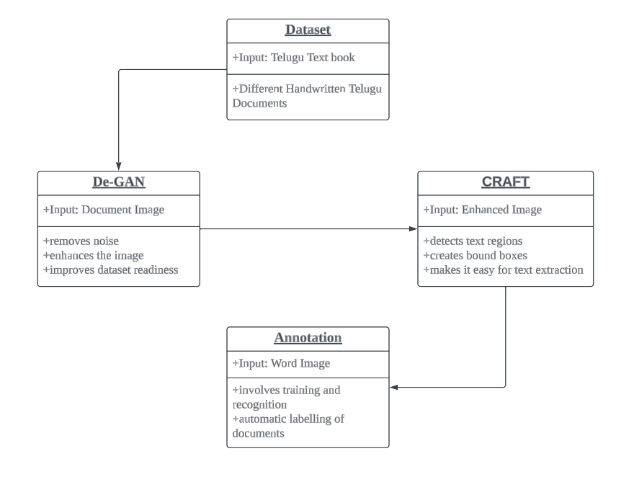
Fig 1:Class Diagram
GOKARAJU RANGARAJU INSTITUTE OF ENGINEERING AND TECHNOLOGY
Department of Computer Science and Engineering
MAJOR Project Phase-II Review-1
Class Diagram:

Slide 9
In Phase 2, the integration process commences with the deployment of the FastText model developed by Facebook for training the 616 identified classes in our dataset. The seamless integration of this word recognizer is essential to harness its capabilities in accurately classifying handwritten words.
Once the training phase is complete, rigorous testing procedures are implemented to evaluate the model's efficacy. This includes comprehensive assessments to gauge its accuracy, precision, and recall in recognizing the diverse set of 616 classes.
Furthermore, the annotation process is a crucial step in validating the model's performance. Employing a dual strategy, we conduct manual annotation to ensure precision, while also leveraging automated annotation techniques to streamline the process. This meticulous approach aims to validate the model's output against the original handwritten images, ensuring a robust and reliable integration in our ongoing project.
Fig 1:Class Diagram
GOKARAJU RANGARAJU INSTITUTE OF ENGINEERING AND TECHNOLOGY
Department of Computer Science and Engineering
MAJOR Project Phase-II Review-1
Module Integration and Testing

Slide 10
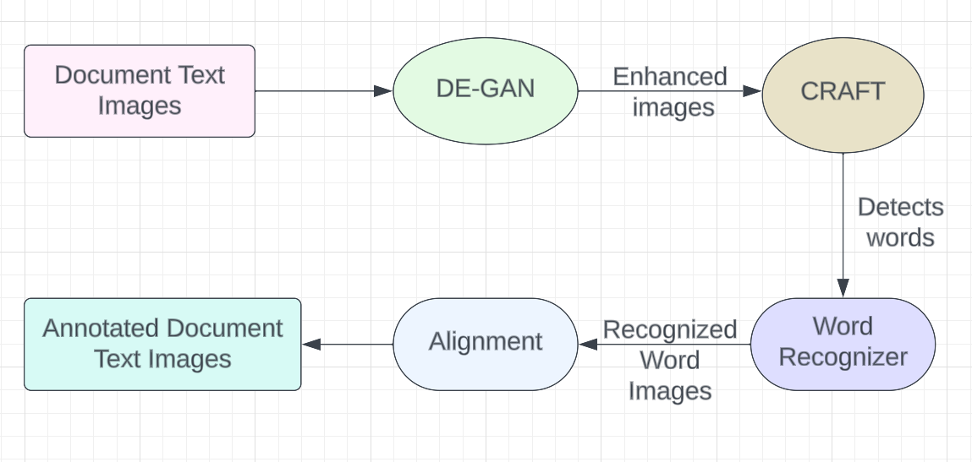
Fig 2: Module Integration
GOKARAJU RANGARAJU INSTITUTE OF ENGINEERING AND TECHNOLOGY
Department of Computer Science and Engineering
MAJOR Project Phase-II Review-1
Module Integration

Slide 11
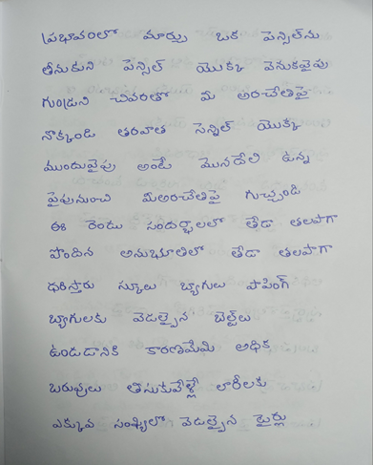
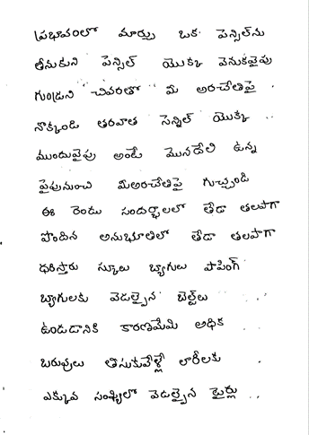
GOKARAJU RANGARAJU INSTITUTE OF ENGINEERING AND TECHNOLOGY
Department of Computer Science and Engineering
MAJOR Project Phase-II Review-1
Testing
ID | Test Data | Output
1

Slide 12
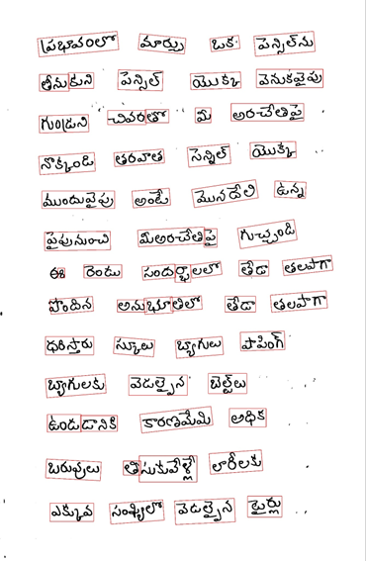
GOKARAJU RANGARAJU INSTITUTE OF ENGINEERING AND TECHNOLOGY
Department of Computer Science and Engineering
MAJOR Project Phase-II Review-1
Testing
ID | Test Data | Output
2

Slide 13
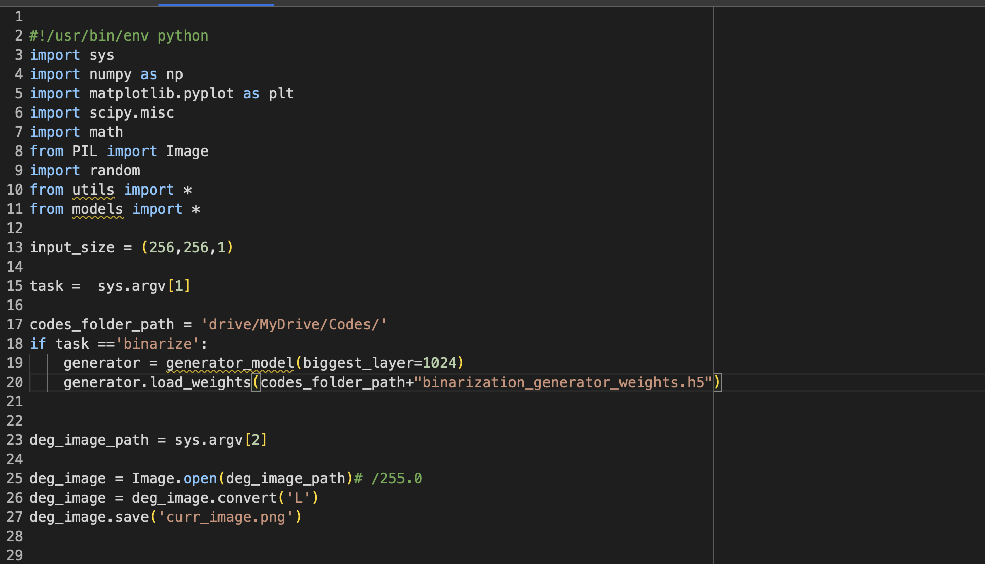
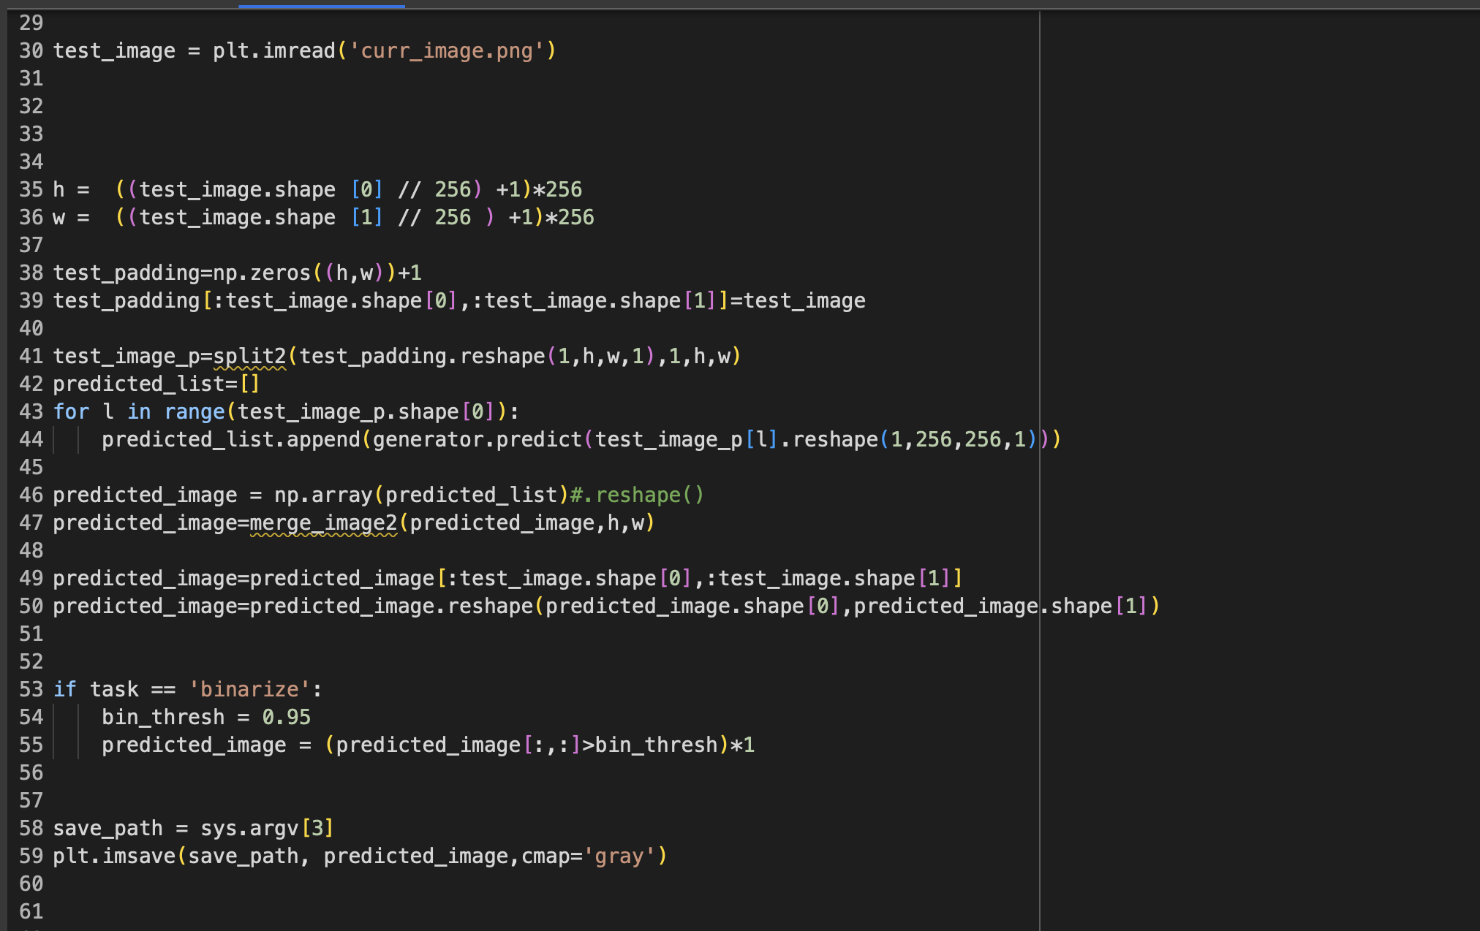
GOKARAJU RANGARAJU INSTITUTE OF ENGINEERING AND TECHNOLOGY
Department of Computer Science and Engineering
MAJOR Project Phase-II Review-1
Implemented Code:
Fig 3: De-GAN Module Fig 4: De-GAN

Slide 14
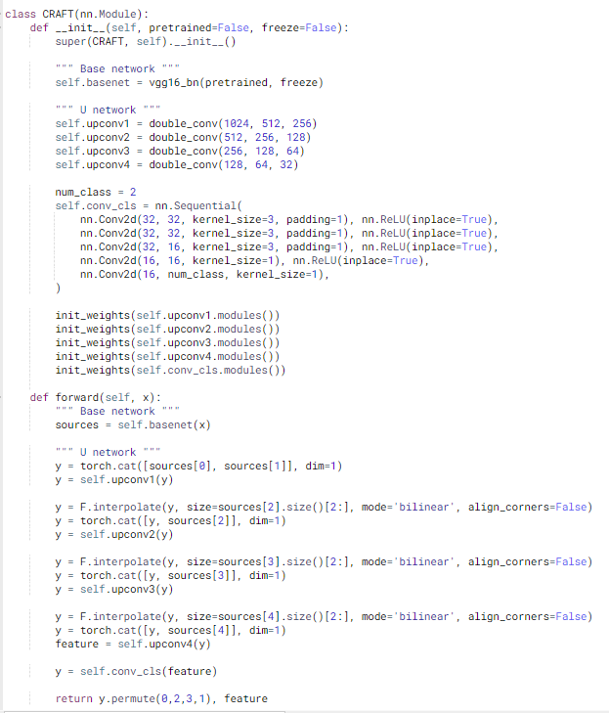
Fig 5: CRAFT Module
GOKARAJU RANGARAJU INSTITUTE OF ENGINEERING AND TECHNOLOGY
Department of Computer Science and Engineering
MAJOR Project Phase-II Review-1
Implemented Code:

Slide 15
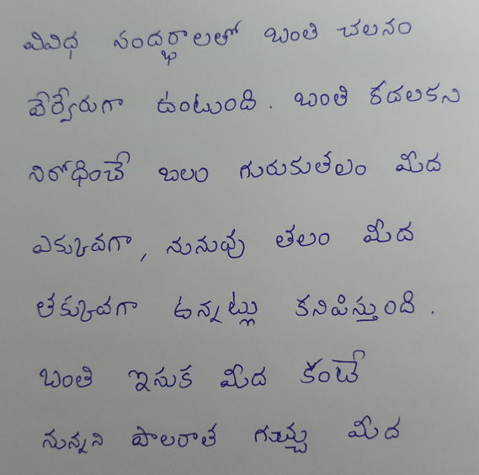
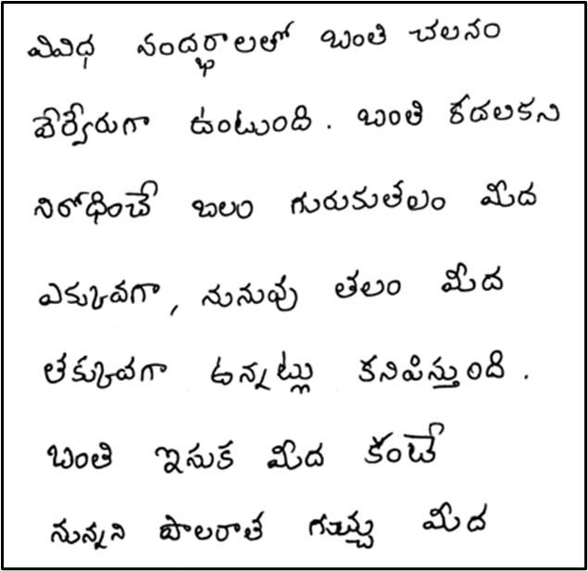
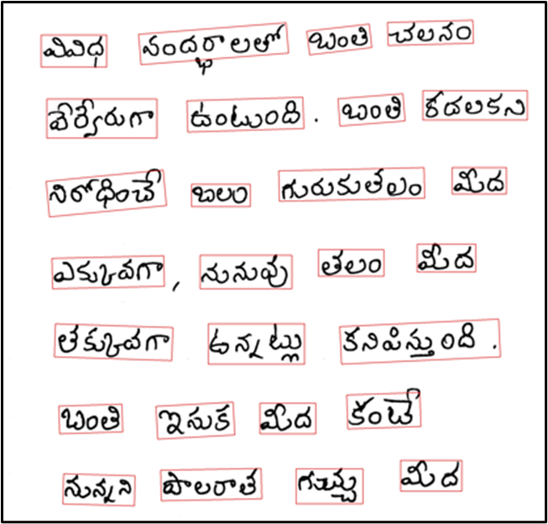
Fig 6: Original Image Fig 7: Image After De-GAN Fig 8: Image After CRAFT
GOKARAJU RANGARAJU INSTITUTE OF ENGINEERING AND TECHNOLOGY
Department of Computer Science and Engineering
MAJOR Project Phase-II Review-1
Screenshots of Modules:

Slide 16
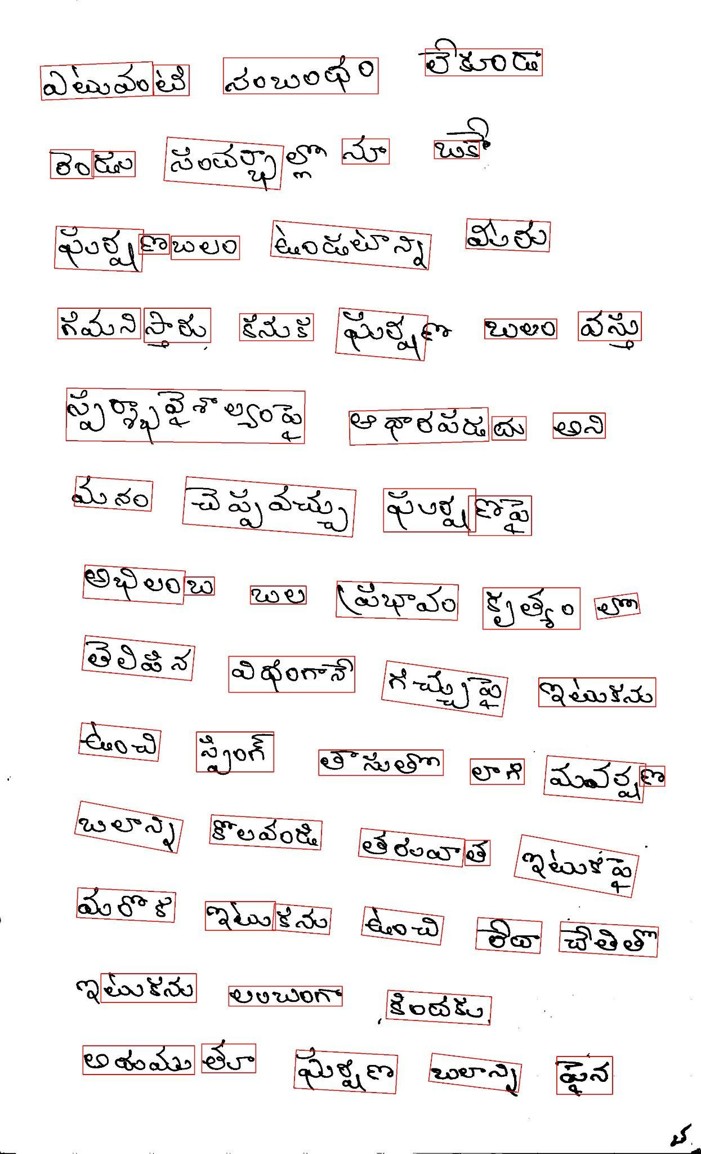
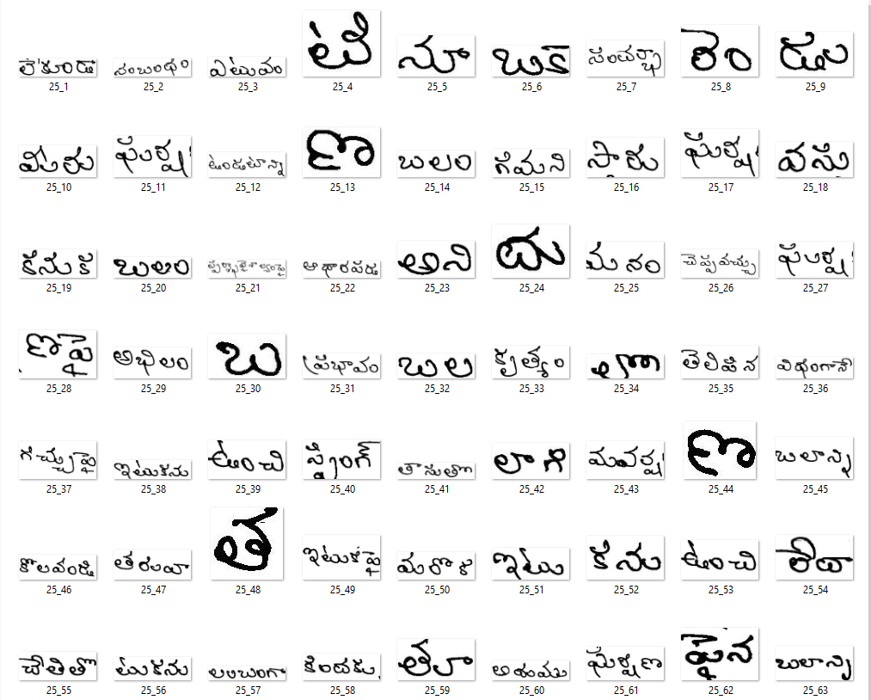
Fig 9: Image After CRAFT Fig 10: Word Images After Cropping
GOKARAJU RANGARAJU INSTITUTE OF ENGINEERING AND TECHNOLOGY
Department of Computer Science and Engineering
MAJOR Project Phase-II Review-1
Screenshots of Modules:

Slide 17
GOKARAJU RANGARAJU INSTITUTE OF ENGINEERING AND TECHNOLOGY
Department of Computer Science and Engineering
MAJOR Project Phase-II Review-1
Conclusion & Scope:
In conclusion, an Automated Annotation System designed for document text images brings transformative benefits to various industries. By leveraging advanced image processing techniques, such as Optical Character Recognition (OCR) and deep learning algorithms, this system significantly enhances document analysis, data extraction, and information retrieval processes. It optimizes efficiency, accuracy, and productivity by automating the time-consuming task of manual annotation. This system finds applications in areas ranging from digitizing historical archives and cataloging large document databases to aiding in content indexing and semantic understanding. As technology continues to advance, the development and adoption of Automated Annotation Systems for Document Text Images hold the promise of revolutionizing the way we interact with and extract knowledge from textual documents.

Slide 18
GOKARAJU RANGARAJU INSTITUTE OF ENGINEERING AND TECHNOLOGY
Department of Computer Science and Engineering
MAJOR Project Phase-II Review-1
References:
1. Souibgui, M. A. and Kessentini, Y., “DE-GAN: A Conditional Generative Adversarial Network for Document Enhancement”, <i>arXiv e-prints</i>, 2020. doi:10.48550/arXiv.2010.08764.9
2. Y. Baek, B. Lee, D. Han, S. Yun and H. Lee, "Character Region Awareness for Text Detection," 2019 IEEE/CVF Conference on Computer Vision and Pattern Recognition (CVPR), Long Beach, CA, USA, 2019, pp. 9357-9366, doi: 10.1109/CVPR.2019.00959.
3. Base paper : Mondal, Ajoy & Tulsyan, Krishna & Jawahar, C.. (2022). Automatic Annotation of Handwritten Documents in Word Level. 10.1145/3571600.3571645.

Slide 19
GOKARAJU RANGARAJU INSTITUTE OF ENGINEERING AND TECHNOLOGY
Department of Computer Science and Engineering
MAJOR Project Phase-II Review-1
References:
4. Marti, U-V., and Horst Bunke. "The IAM-database: an English sentence database for offline handwriting recognition." International Journal on Document Analysis and Recognition 5 (2002): 39-46.
5. Pippi, Vittorio, Silvia Cascianelli, and Rita Cucchiara. "Handwritten Text Generation from Visual Archetypes." Proceedings of the IEEE/CVF Conference on Computer Vision and Pattern Recognition. 2023.
6. Mustafa, W. A., et al."A comprehensive review on document image (DIBCO) database."IOP Conference Series: Materials Science and Engineering . V ol. 557. No. 1. IOP Publishing, 2019.
7. Zhou, X., “EAST: An Efficient and Accurate Scene Text Detector” , <i>arXiv e-prints</i>, 2017.doi:10.48550/arXiv.1704.03155 .

Slide 20
GOKARAJU RANGARAJU INSTITUTE OF ENGINEERING AND TECHNOLOGY
Department of Computer Science and Engineering
MAJOR Project Phase-II Review-1
References:
8. Liu, Yuliang, et al. "Abcnet: Real-time scene text spotting with adaptive bezier-curve network." proceedings of the IEEE/CVF conference on computer vision and pattern recognition. 2020.
9. Z. Zhong, L. Jin and S. Huang, "DeepText: A new approach for text proposal generation and text detection in natural images," 2017 IEEE International Conference on Acoustics, Speech and Signal Processing (ICASSP), New Orleans, LA, USA, 2017, pp. 1208-1212, doi: 10.1109/ICASSP.2017.7952348.
10. Ait Bella, F.Z., El Rhabi, M., Hakim, A. et al. An innovative document image binarization approach driven by the non-local p-Laplacian. EURASIP J. Adv. Signal Process. 2022, 50 (2022).
11. Mustafa, Wan & Kader, Mohamed. (2018). Binarization of Document Images: A Comprehensive Review. Journal of Physics: Conference Series. 1019. 012023. 10.1088/1742-6596/1019/1/012023.

Slide 21
GOKARAJU RANGARAJU INSTITUTE OF ENGINEERING AND TECHNOLOGY
Department of Computer Science and Engineering
MAJOR Project Phase-II Review-1
References:
12. Coquenet, Denis & Chatelain, Clement & Paquet, Thierry. (2020). End-to-end Handwritten Paragraph Text Recognition Using a Vertical Attention Network.
13. Ganji, T., Sekhar Velpuru, M., and Dugyala, R., “Multi Variant Handwritten Telugu Character Recognition Using Transfer Learning”, in <i>Materials Science and Engineering Conference Series</i>, 2021, vol. 1042, no. 1, p. 012026. doi:10.1088/1757-899X/1042/1/012026.
14. Mathew, Minesh, and C. V. Jawahar. "An empirical study of CTC based models for OCR of Indian languages." arXiv preprint arXiv:2205.06740 (2022).
15. Trippe, Theophil, et al. "Let's enhance: A deep learning approach to extreme deblurring of text images." arXiv preprint arXiv:2211.10103 (2022).

Slide 22
GOKARAJU RANGARAJU INSTITUTE OF ENGINEERING AND TECHNOLOGY
Department of Computer Science and Engineering
MAJOR Project Phase-II Review-1
Status of phase-1 Paper publication :
We have submitted a major project phase-1 review paper titled “ A review on Automated Annotation System for Document Text Images” at the 2024 International Conference on Cognitive, Green, and Ubiquitous Computing (IC-CGU) and are currently awaiting the results.

Slide 23
THANK YOU & QUERY
GOKARAJU RANGARAJU INSTITUTE OF ENGINEERING AND TECHNOLOGY
Department of Computer Science and Engineering
MAJOR Project Phase-II Review-1

